Slide 1
Final Project – SQL, Python, and Basic Analytics
MSDS 5013/DS 3213
Presented by Caleb Chronowski, Tory Legg, and Kris Nolan

Slide 2
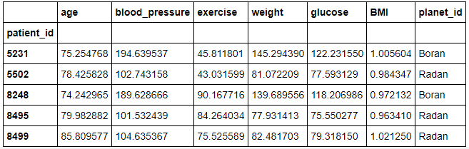
Distributions on each planet

Slide 3
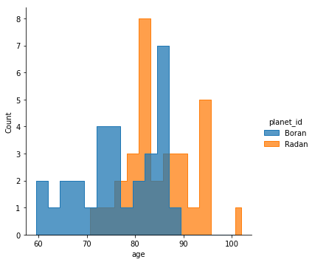
Histogram of Age Distribution on each planet

Slide 4
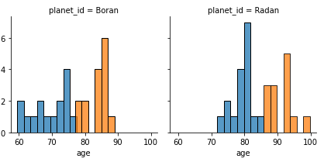
Age Value by planet
Notes:
Average value of planet for age
Created a function to check if patient’s age is over or under life expectancy
Created a new binary column to store whether or not patient exceeded average age

Slide 5
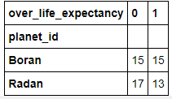
Notes:
The mean life expectancy, assuming that the 'age' column corresponds to the age of each patient's death, is 76.42 years on Boran and 84.22 years on Radan.

Slide 6
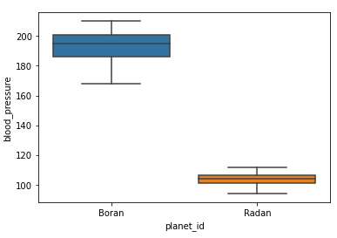
Blood Pressure Box Plot
Notes:
This draws the conclusion that there must be some strong gravity or terrible diets on Boran. The distribution of blood pressures is much larger on Boran, but that makes sense given how much higher the mean blood pressure is. Neither planet had any notable outliers.

Slide 7
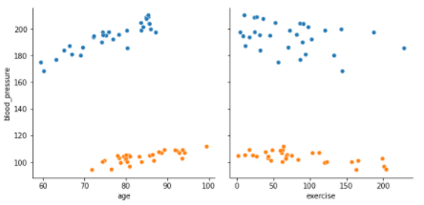
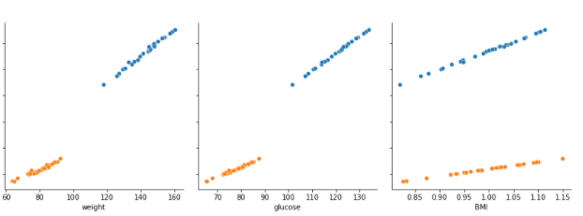
Blood Pressure Scatterplots
Notes:
Blood pressure has really strong correlations between weight, glucose and BMI. There's clear colinearity. There's a weaker correlation with age, but it's still visible. The data is much noisier for exercise.

